Slide 1
Data ENGINEERING pipeline using aMAZON web services
DSCI6007 – Carles Poles-Mielgo

Slide 2
Architecture diagram

Slide 3
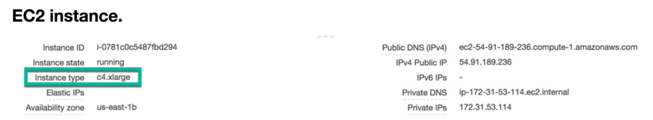
AWS instances – EC2

Slide 4
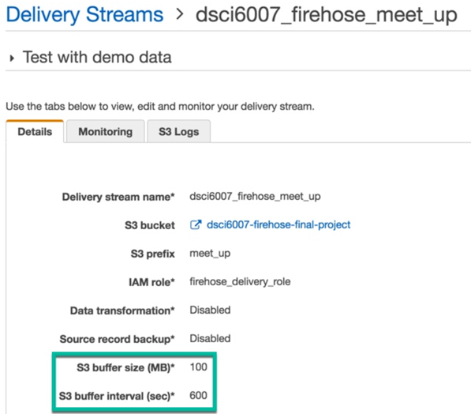
AWS instances - kinesis

Slide 5
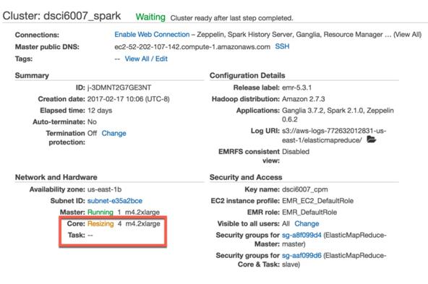
AWS instances - emr

Slide 6
MEETUP - API
Using ‘requests.get("http://api.meetup.com/2/groups", params=params)’
No need to ‘pip install meetup-api’ on ec2.
Making 200 requests per hour to avoid been been throttle out by MeetUp (~100MB).
MeetUp documentation does not specify the requests limit, just “avoid making too many calls per hour” or you will be throttle out for an hour (and you will be inserting garbish into S3).

Slide 7
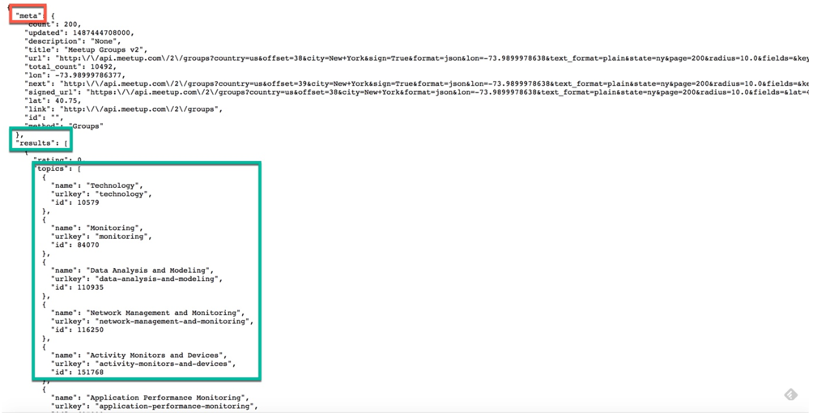
MEETUP – json data

Slide 8
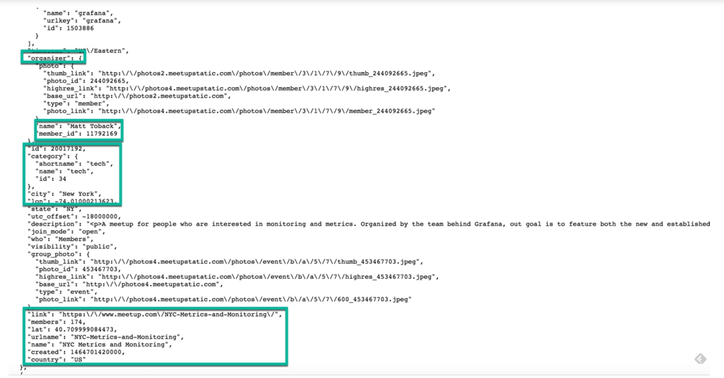
MEETUP – json data

Slide 9
MEETUP – json data

Slide 10
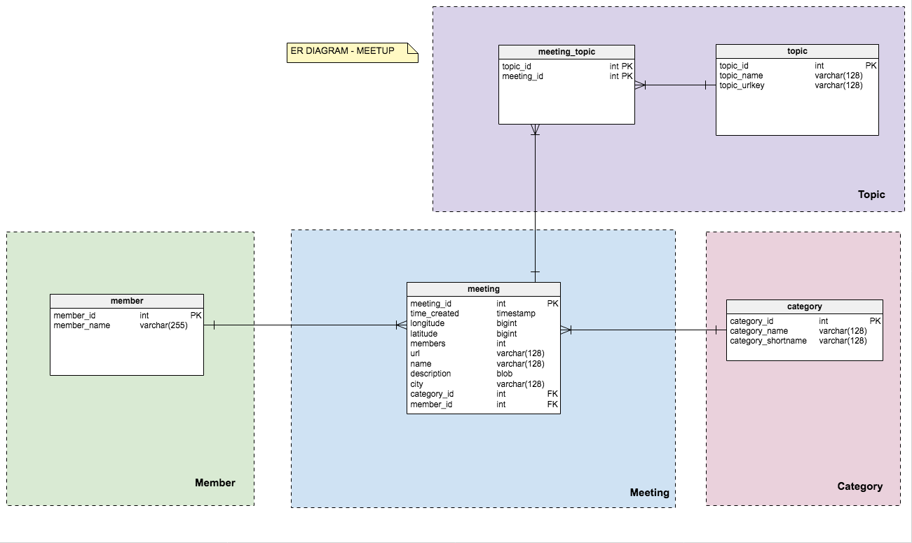
MEETUP – ER diagram

Slide 11
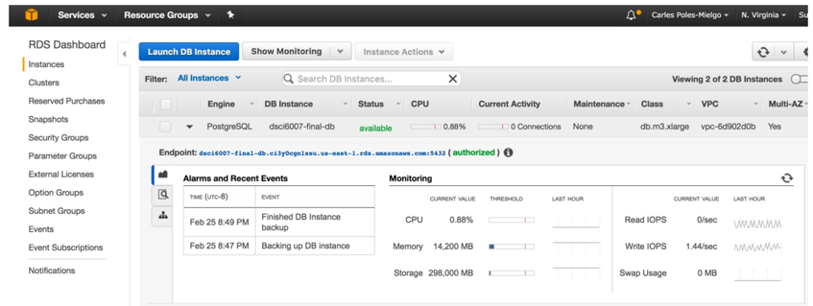
Aws instances – rds postgresql

Slide 12
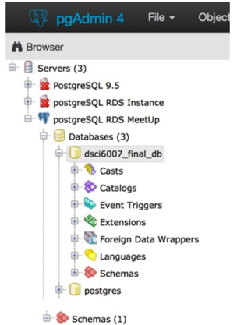
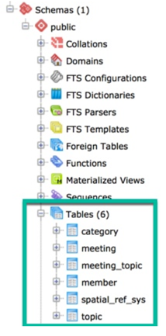
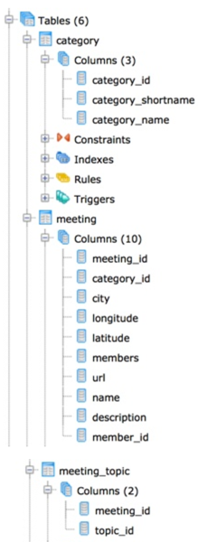
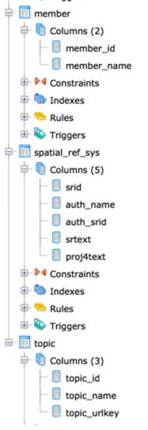
Aws instances – rds postgresql

Slide 13
Ec2 – cron jobs
Hourly job to load (‘raw’) json into S3 bucket using kinesis firehose.
Hourly job to generate reports on S3 bucket size and number of objects.
Free email alert from wdt.io:

Slide 14
Ec2 – free cron job email alert

Slide 15
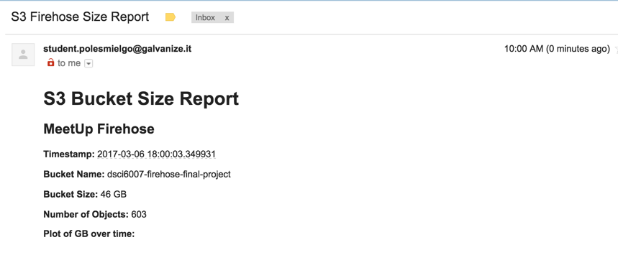
Ec2 – s3 reports

Slide 16
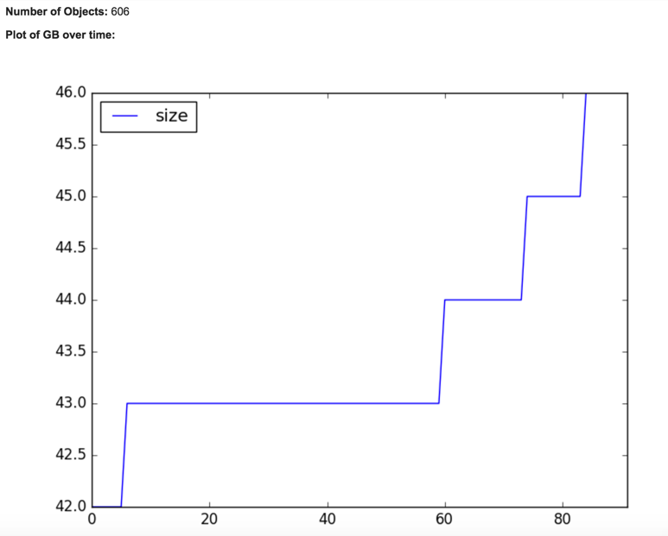
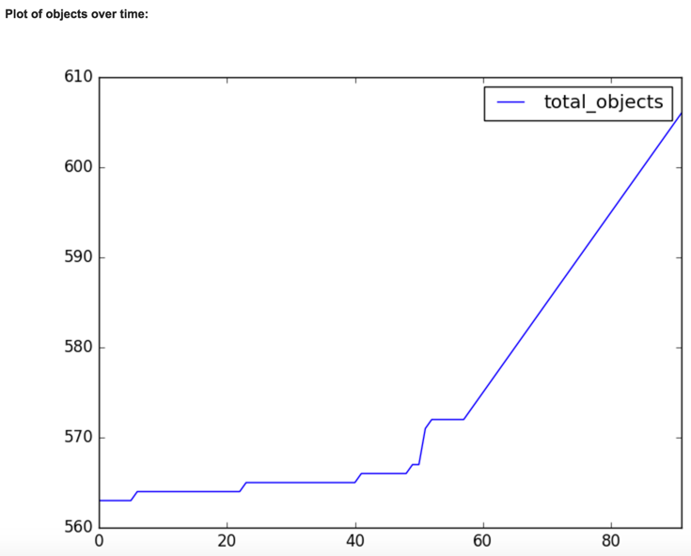
Ec2 – s3 reports

Slide 17
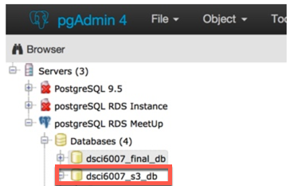
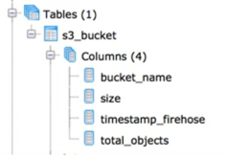
Ec2 – s3 reports

Slide 18
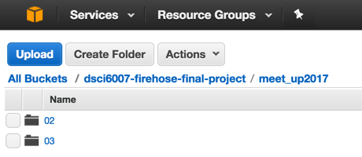
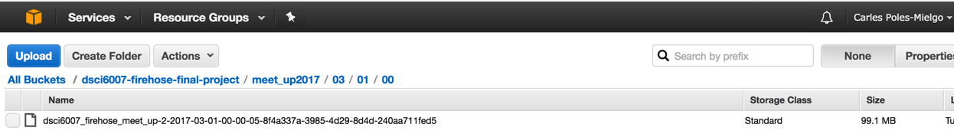
s3 bucket – raw json

Slide 19
EMR spark – normalizing data
CRON job runs every 3 hours.
It normalizes raw json.
Saves 3NF data into different S3 bucket.
Creates html reports copied over S3 static website bucket (another CRON job copies the files from EMR master node to the S3 static website bucket).

Slide 20
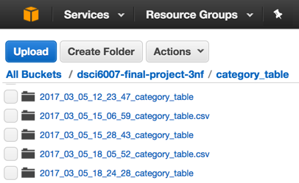
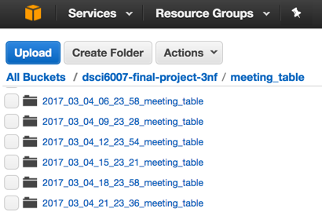
S3 bucket – normalizing data

Slide 21
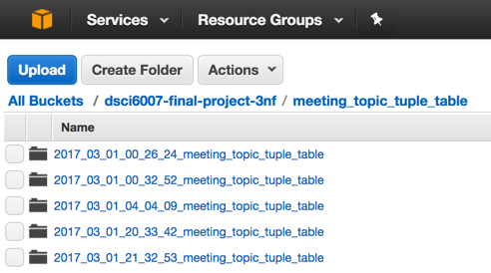
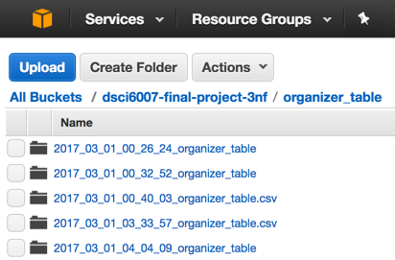
S3 bucket – normalizing data

Slide 22
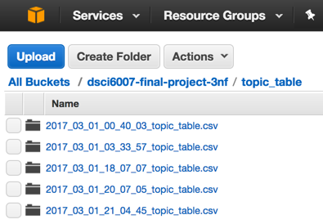
S3 bucket – normalizing data

Slide 23
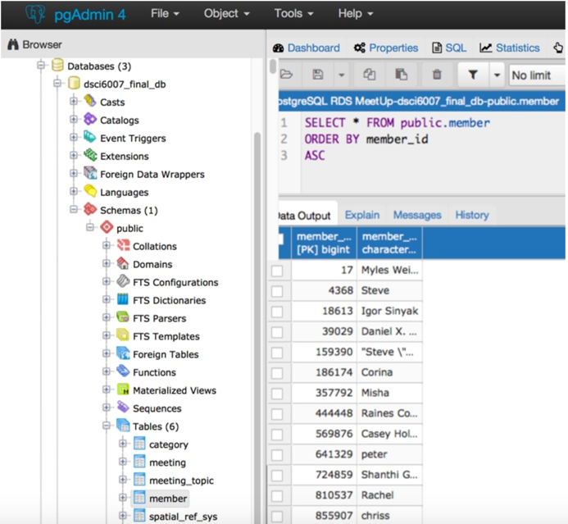
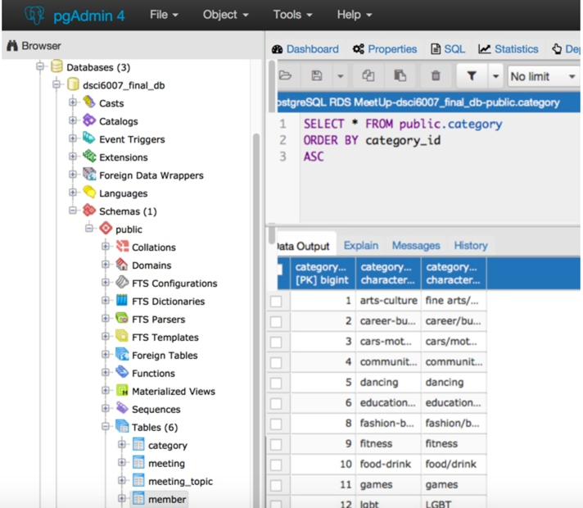
postgresql

Slide 24
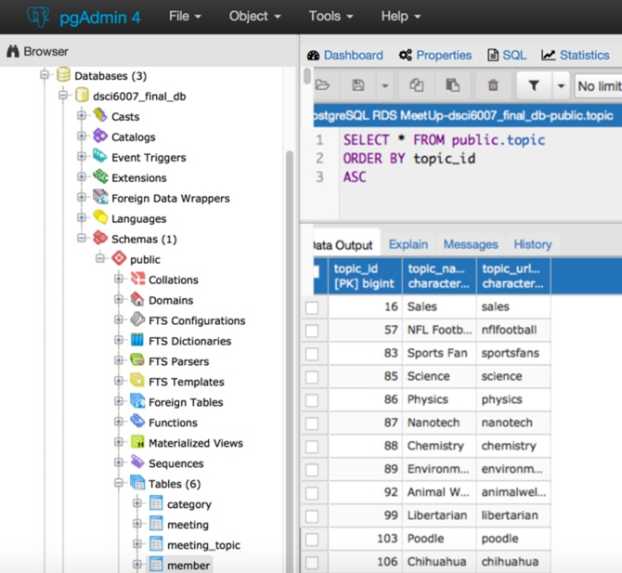
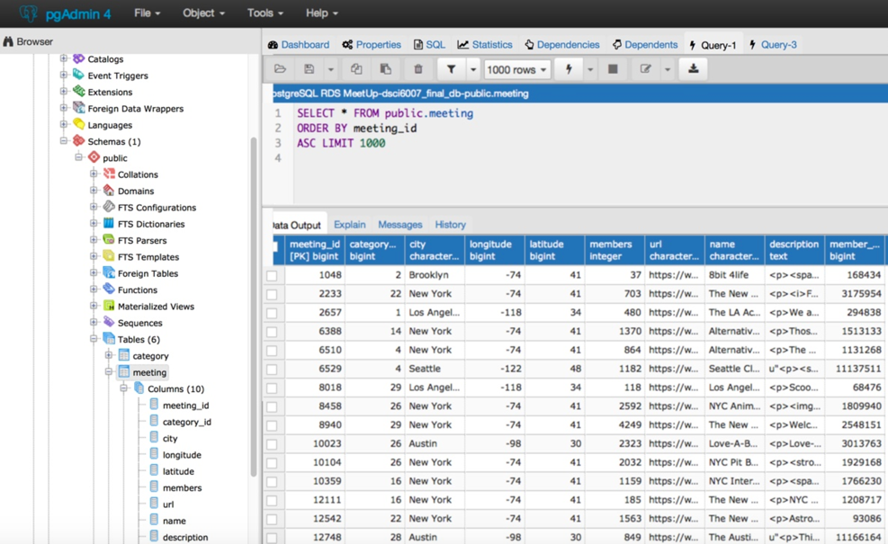
postgresql

Slide 25
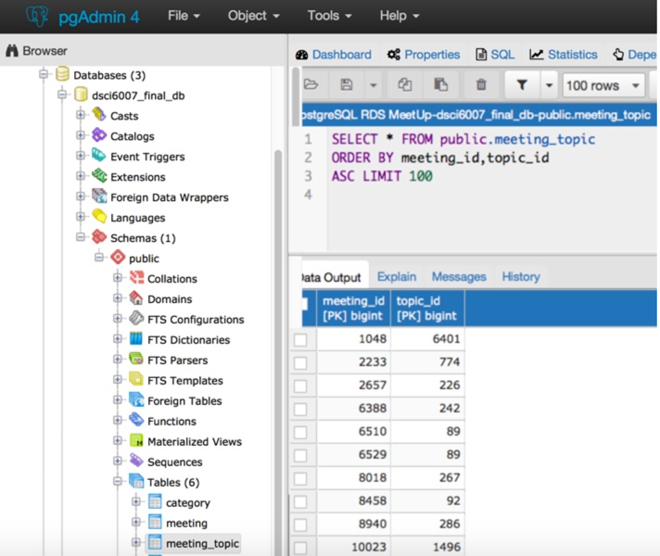
postgresql

Slide 26
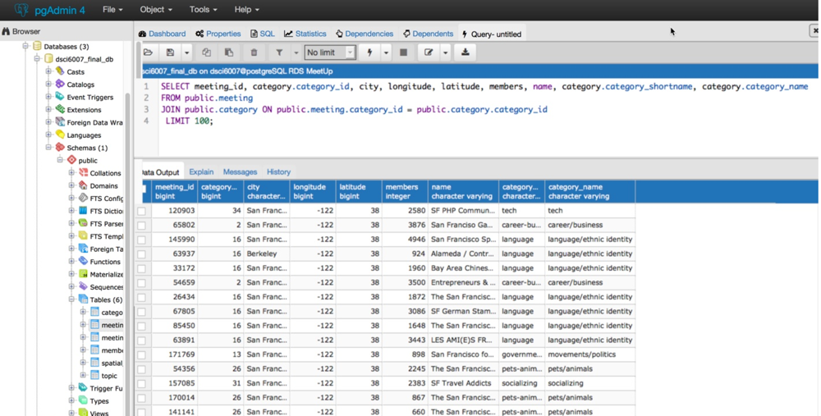
postgresql

Slide 27
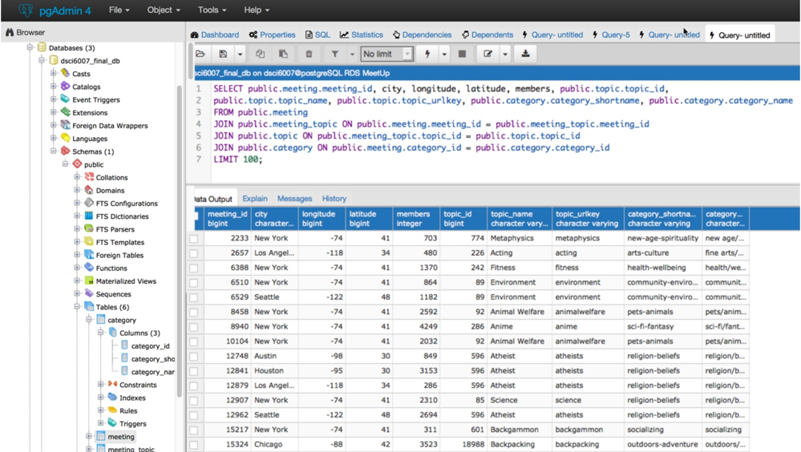
postgresql

Slide 28
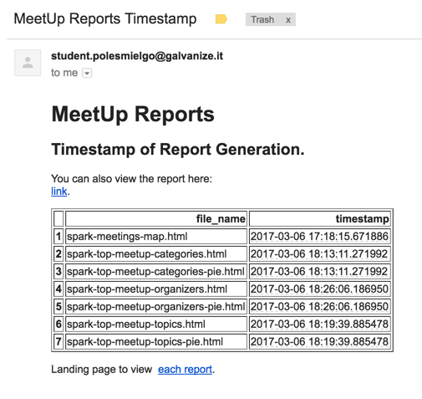
Html reports – s3 static website
CRON job to check files timestamp.

Slide 29
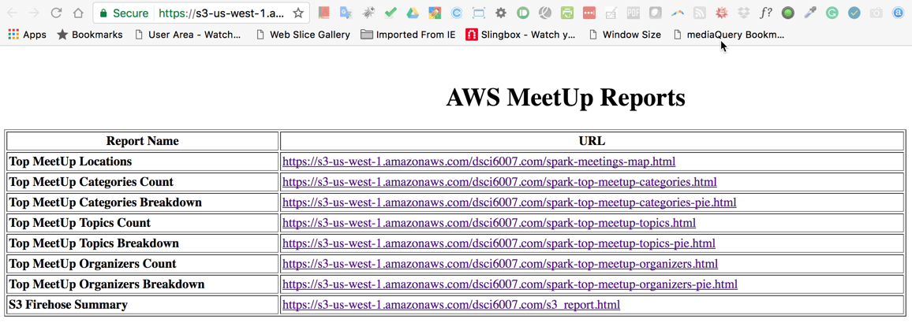
Html reports – s3 static website
https://s3-us-west-1.amazonaws.com/dsci6007.com/meetup_summary_reports.html

Slide 30
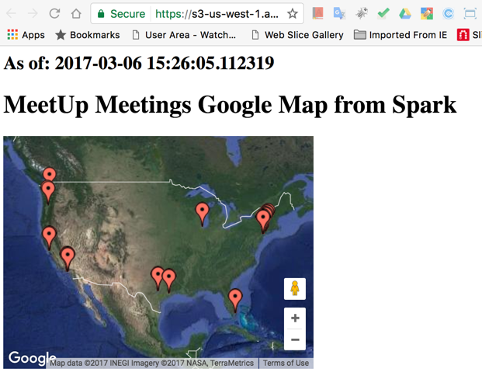
Html reports – s3 static website
https://s3-us-west-1.amazonaws.com/dsci6007.com/spark-meetings-map.html

Slide 31
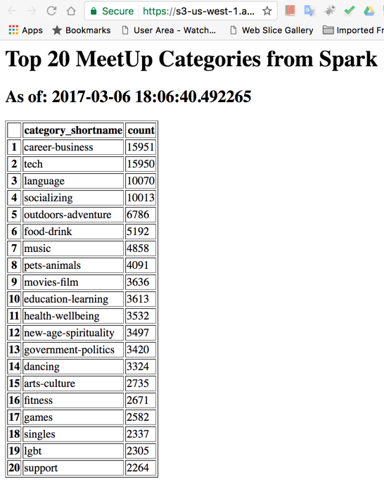
Html reports – s3 static website
https://s3-us-west-1.amazonaws.com/dsci6007.com/spark-top-meetup-categories.html

Slide 32
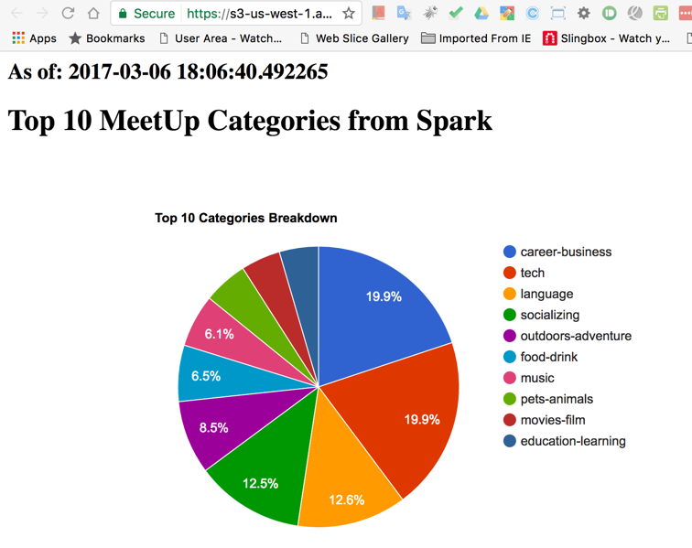
Html reports – s3 static website
https://s3-us-west-1.amazonaws.com/dsci6007.com/spark-top-meetup-categories-pie.html

Slide 33
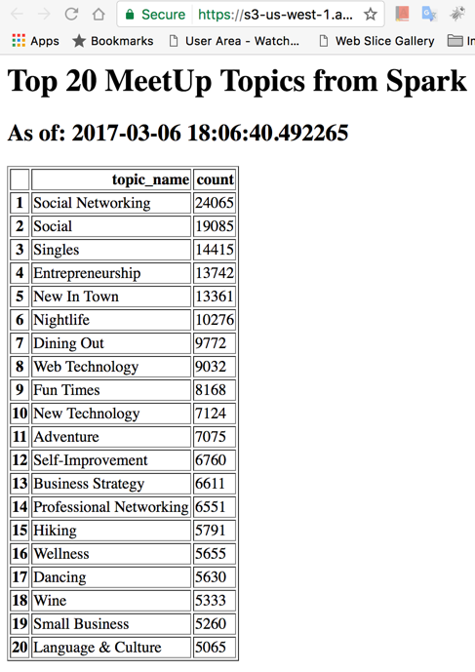
Html reports – s3 static website
https://s3-us-west-1.amazonaws.com/dsci6007.com/spark-top-meetup-topics.html

Slide 34
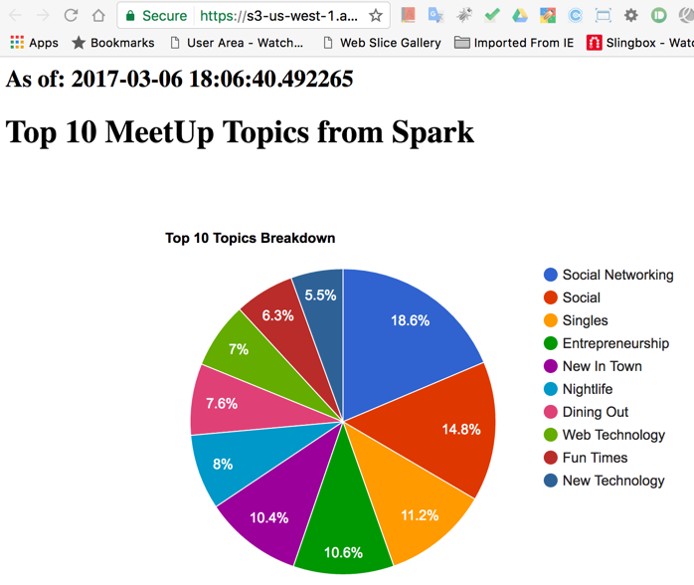
Html reports – s3 static website
https://s3-us-west-1.amazonaws.com/dsci6007.com/spark-top-meetup-topics-pie.html

Slide 35
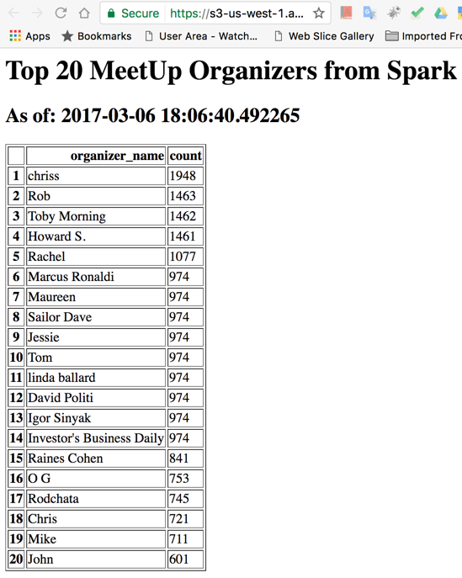
Html reports – s3 static website
https://s3-us-west-1.amazonaws.com/dsci6007.com/spark-top-meetup-organizers.html

Slide 36
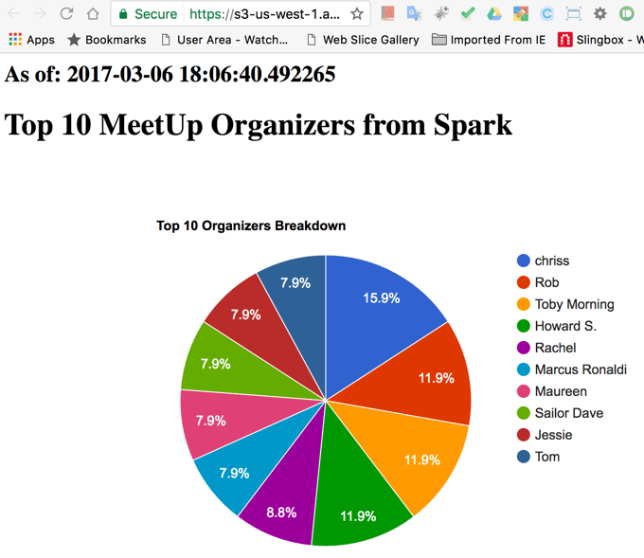
Html reports – s3 static website
https://s3-us-west-1.amazonaws.com/dsci6007.com/spark-top-meetup-organizers-pie.html

Slide 37
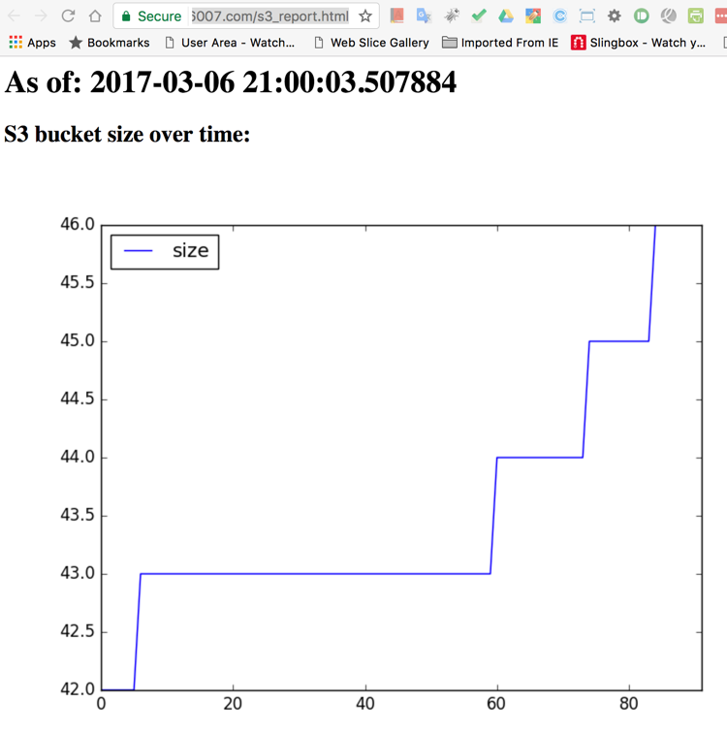
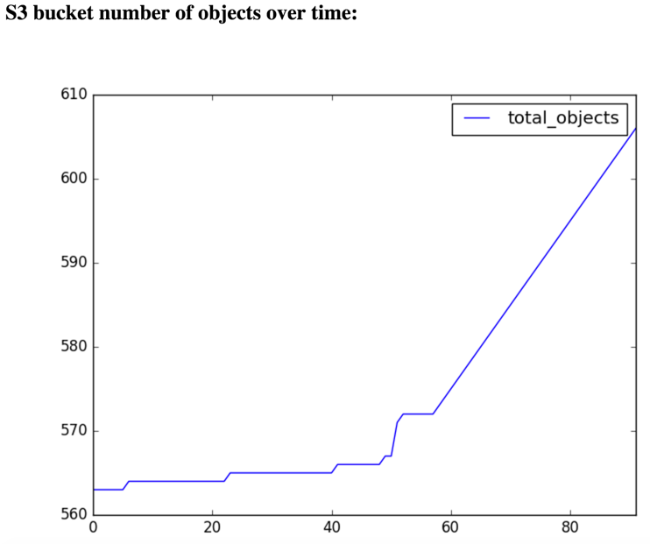
Html reports – s3 static website
https://s3-us-west-1.amazonaws.com/dsci6007.com/s3_report.html

Slide 38
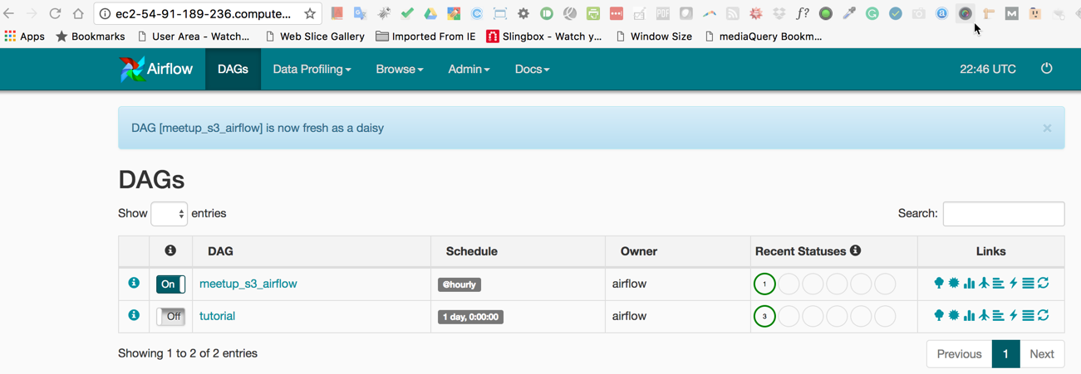
AIRFLOW IMPLEMENTATION (moving away from CRON)
http://ec2-54-91-189-236.compute-1.amazonaws.com:8080/admin/

Slide 39
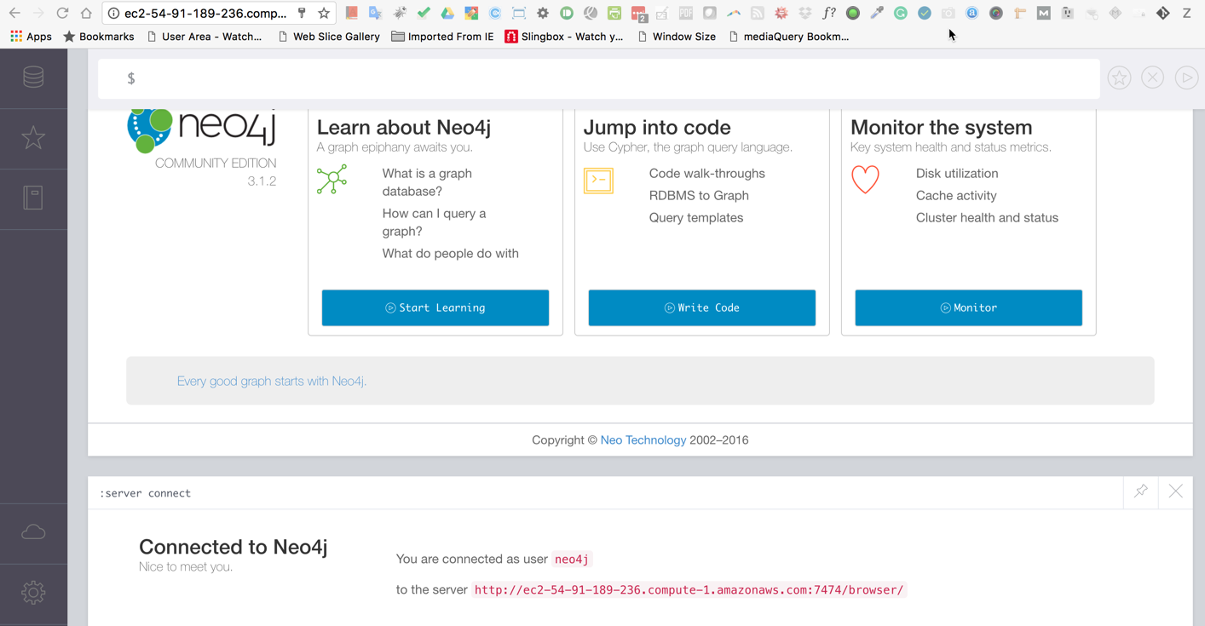
Neo4j implementation (NoSQL Graphdb)
http://ec2-54-91-189-236.compute-1.amazonaws.com:7474/browser/

Slide 40
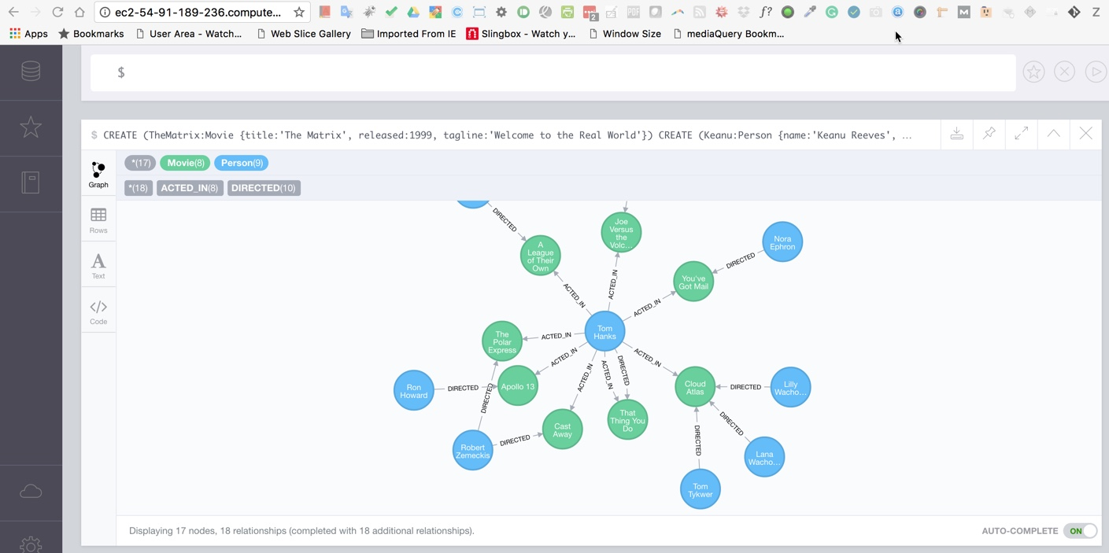
Neo4j implementation (NoSQL Graphdb)
http://ec2-54-91-189-236.compute-1.amazonaws.com:7474/browser/

Slide 41
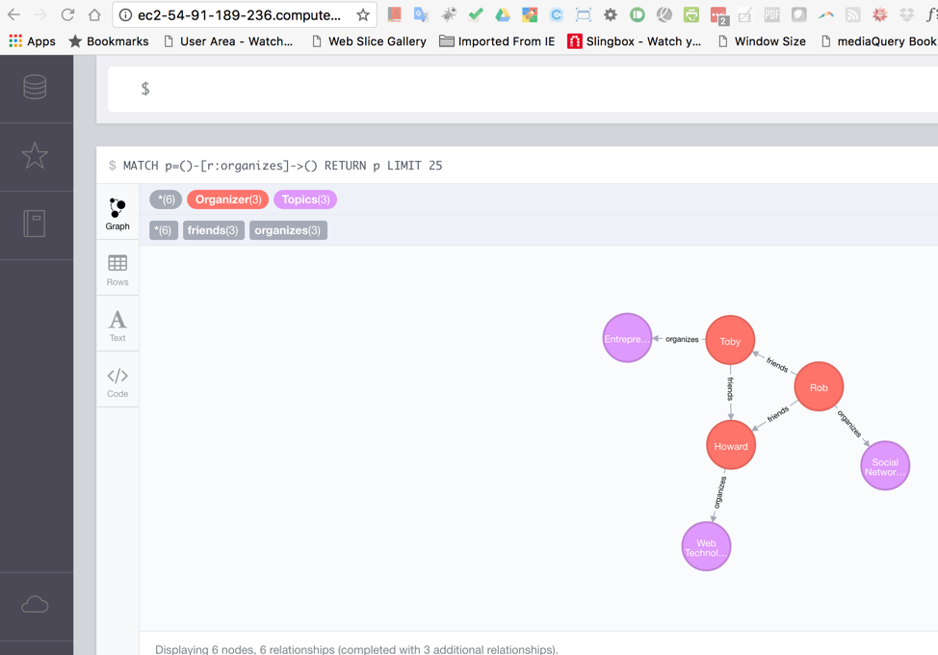
Neo4j implementation (NoSQL Graphdb)
http://ec2-54-91-189-236.compute-1.amazonaws.com:7474/browser/

Slide 42
FUTURE WORK
Use POST-GIS with POSTGRESQL (already enabled).
Use Neo4j to plot “social networks/meetings”.
Finish implementation of AIRFLOW to move away from CRON.
Use NLP with meeting description data.
Implement Spyre.

Slide 43
